Slide 1
Progettazione di Sistemi Digitali
Docente: Salvatore Pontarelli

Slide 2
Informazioni
Email docente: salvatore.pontarelli@uniroma1.it
Orario delle lezioni:
martedi dalle 11:00 alle 13:00
venerdì dalle 10:00 alle 13:00
Ricevimento:
Contattare il docente via email
Materiale didattico:
Libro di testo (da cui sono tratti i lucidi)
Harris & Harris, Digital Design and Computer Architecture, ARM Ed., Morgan Kaufmann 2016.
Modalità d'esame: esame finale scritto e orale

Slide 3
Finalità del corso
Il corso di Progettazione di Sistemi Digitali tratta argomenti preliminari alla descrizione dell'organizzazione di un calcolatore: rappresentazione dell'informazione, progettazione di reti combinatorie e sequenziali, registri e loro interconnessione. Tale corso fornisce quindi gli strumenti necessari alla comprensione del funzionamento e delle problematiche di progetto di un calcolatore, argomenti che verranno trattati nel corso di Architettura degli Elaboratori.

Slide 4
Programma
Il corso copre i seguenti argomenti:
basi della logica binaria: porte logiche, sistemi di numerazione, rappresentazione dell’informazione
progettazione di sistemi combinatori: equazioni booleane, algebra booleana, mappe K, blocchi combinatori, timing
progettazione di sistemi sequenziali: Latch e Flip-Flop, progettazione di logica sincrona, macchine a stati finiti, tempistiche della logica sequenziale.
linguaggi descrittivi hardware (hdl): logica combinatoria, logica sequenziale, macchine a stati finiti, system verilog, VHDL
blocchi digitali costitutivi: circuiti aritmetici, blocchi sequenziali, matrici di memoria, matrici logiche.

Slide 5
Binary number system

Slide 6
Number Systems
Decimal numbers
Binary numbers

Slide 7
Powers of Two
2⁰ = 1
2¹ = 2
2² = 4
2³ = 8
2⁴ = 16
2⁵ = 32
2⁶ = 64
2⁷ = 128
2⁸ = 256
2⁹ = 512
2¹⁰ = 1024
2¹¹ = 2048
2¹² = 4096
2¹³ = 8192
2¹⁴ = 16384
2¹⁵ = 32768

Slide 8
Number Conversion
Binary to decimal conversion:
Convert 10011₂ to decimal
16×1 + 8×0 + 4×0 + 2×1 + 1×1 = 19₁₀
Decimal to binary conversion:
Convert 47₁₀ to binary
32×1 + 16×0 + 8×1 + 4×1 + 2×1 + 1×1 = 101111₂

Slide 9
Decimal to Binary Conversion
Two methods:
Method 1:
Find the largest power of 2 that fits,
subtract
if not zero, repeat
Method 2:
divide by 2,
put the remainder to the left of the binary representation

Slide 10
Decimal to Binary Conversion
53₁₀
Method 1: Find the largest power of 2 that fits, subtract and repeat
53₁₀ 32×1
53-32 = 21 16×1
21-16 = 5 4×1
5-4 = 1 1×1 = 110101₂
Method 2: Repeatedly divide by 2, remainder goes in next most significant bit
53₁₀ = 53/2 = 26 R1
26/2 = 13 R0
13/2 = 6 R1
6/2 = 3 R0
3/2 = 1 R1
1/2 = 0 R1 = 110101₂

Slide 11
Decimal to Binary Conversion
Another example: Convert 75₁₀ to binary.
75₁₀= 64 + 8 + 2 + 1 = 1001011₂
or
75/2 = 37 R1
37/2 = 18 R1
18/2 = 9 R0
9/2 = 4 R1
4/2 = 2 R0
2/2 = 1 R0
1/2 = 0 R1

Slide 12
Binary Values and Range
N-digit decimal number
How many values? 10^{N}
Range? [0, 10^{N} - 1]
Example: 3-digit decimal number:
10³ = 1000 possible values
Range: [0, 999]
N-bit binary number
How many values? 2^{N}
Range: [0, 2^{N} - 1]
Example: 3-digit binary number:
2³ = 8 possible values
Range: [0, 7] = [000₂ to 111₂]

Slide 13
Hexadecimal Numbers
Hex Digit | Decimal Equivalent | Binary Equivalent
0 | 0 | 0000
1 | 1 | 0001
2 | 2 | 0010
3 | 3 | 0011
4 | 4 | 0100
5 | 5 | 0101
6 | 6 | 0110
7 | 7 | 0111
8 | 8 | 1000
9 | 9 | 1001
A | 10 | 1010
B | 11 | 1011
C | 12 | 1100
D | 13 | 1101
E | 14 | 1110
F | 15 | 1111

Slide 14
Hexadecimal Numbers
Base 16
Shorthand for binary

Slide 15
Hexadecimal to Binary Conversion
Hexadecimal to binary conversion:
Convert 4AF₁₆ (also written 0x4AF) to binary
0100 1010 1111₂
Hexadecimal to decimal conversion:
Convert 4AF₁₆ to decimal
16²×4 + 16¹×10 + 16⁰×15 = 1199₁₀

Slide 16
Bits, Bytes, Nibbles…
Bits
Bytes & Nibbles
Bytes

Slide 17
Large Powers of Two
2¹⁰ = 1 kilo ≈ 1000 (1024)
2²⁰ = 1 mega ≈ 1 million (1,048,576)
2³⁰ = 1 giga ≈ 1 billion (1,073,741,824)

Slide 18
Estimating Powers of Two
What is the value of 2²⁴?
2⁴ × 2²⁰ ≈ 16 million
How many values can a 32-bit variable represent?
2² × 2³⁰ ≈ 4 billion

Slide 19
Addition
Decimal
Binary

Slide 20

Hexadecimal Addition Examples
Add the following 4-digit hex numbers
Subtract the following 4-digit hex numbers
3A09
1B17
3D09
1B27

Slide 21
Hexadecimal Addition Examples
101
Add the following 4-digit hex numbers
Subtract the following 4-digit hex numbers
3A09
1B17
5520
3D09
1B27

Slide 22
Hexadecimal Addition Examples
101
Add the following 4-digit hex numbers
Subtract the following 4-digit hex numbers
3A09
1B17
5520
1
3D09
1B27
21E2

Slide 23
Binary Addition Examples
Add the following 4-bit binary numbers
Add the following 4-bit binary numbers

Slide 24
Overflow
Digital systems operate on a fixed number of bits
Overflow: when result is too big to fit in the available number of bits
See previous example of 11 + 6

Slide 25
Signed Binary Numbers
Sign/Magnitude Numbers
Two’s Complement Numbers

Slide 26
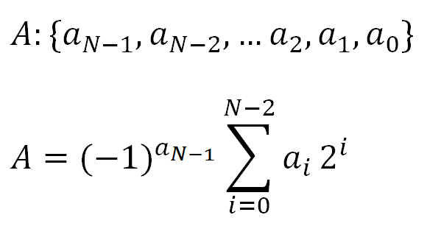
Sign/Magnitude Numbers
1 sign bit, N-1 magnitude bits
Sign bit is the most significant (left-most) bit
Positive number: sign bit = 0
Negative number: sign bit = 1
Example, 4-bit sign/mag representations of ± 6:
+6 = 0110
- 6 = 1110
Range of an N-bit sign/magnitude number:
[-(2^{N-1}-1), 2^{N-1}-1]

Slide 27
Sign/Magnitude Numbers
Problems:
Addition doesn’t work, for example -6 + 6:
1110
+ 0110
10100 (wrong!)
Two representations of 0 (± 0):
1000
0000

Slide 28
Two’s Complement Numbers
Don’t have same problems as sign/magnitude numbers:
Addition works
Single representation for 0

Slide 29
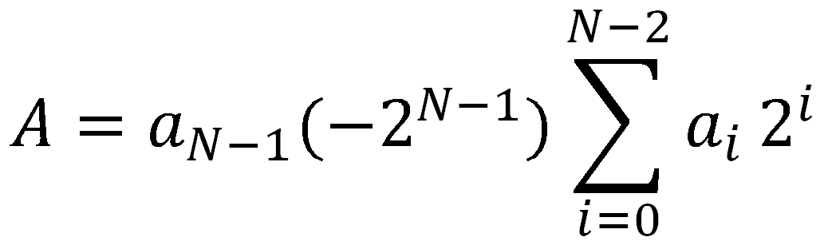
Two’s Complement Numbers
msb has value of -2^{N-1}
Most positive 4-bit number: 0111
Most negative 4-bit number: 1000
The most significant bit still indicates the sign (1 = negative, 0 = positive)
Range of an N-bit two’s complement number:
[-(2^{N-1}), 2^{N-1}-1]
+

Slide 30
“Taking the Two’s Complement”
“Taking the Two’s complement” flips the sign of a two’s complement number
Method:
Invert the bits
Add 1
Example: Flip the sign of 3₁₀ = 0011₂
1100
+ 1
1101 = -3₁₀

Slide 31
Two’s Complement Examples
Take the two’s complement of 6₁₀ = 0110₂
1001
+ 1
1010₂ = -6₁₀
What is the decimal value of the two’s complement number 1001₂?
0110
+ 1
0111₂ = 7₁₀, so 1001₂ = -7₁₀

Slide 32
Two’s Complement Addition
Add 6 + (-6) using two’s complement numbers
Add -2 + 3 using two’s complement numbers

Slide 33
Two’s Complement Addition
Add 6 + (-6) using two’s complement numbers
Add -2 + 3 using two’s complement numbers

Slide 34
Increasing Bit Width
Extend number from N to M bits (M > N) :
Sign-extension
Zero-extension

Slide 35
Fine lezione
Per la prossima lezione:
Fare esercizi PSD1-esercizi
Studiare paragrafi 1.4 e 5.3 del libro

